Slide 1

IF I WAS A POKÉMON…WHERE WOULD I BE? A CASE STUDY OF PREDICTIVE ANALYTICS
By: Parker Mills
Joseph Muhia
Marina(Tiger)Hobday Zachary Cohen

Slide 2
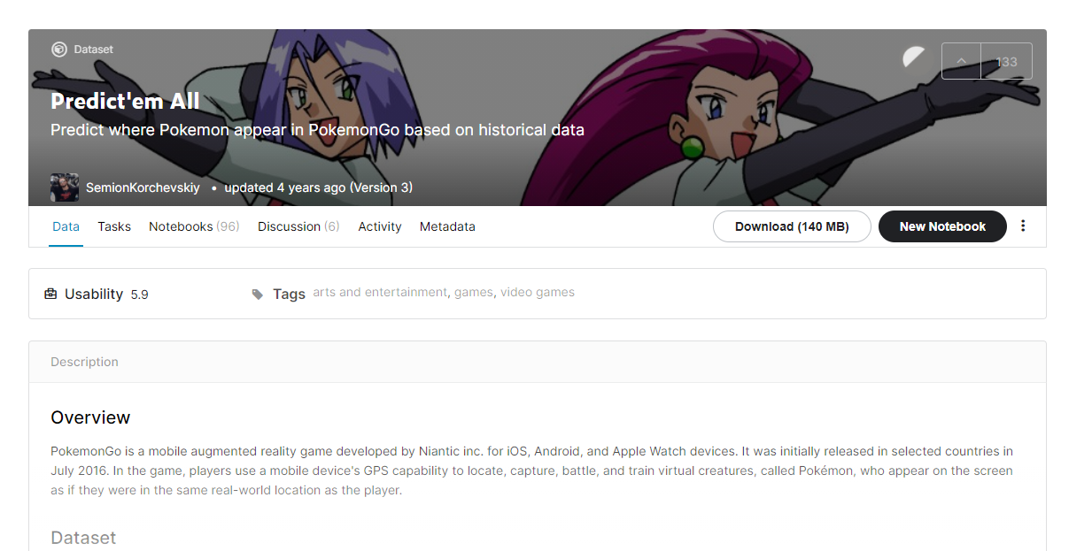
ETL PROCESS:
Step 1: PROJECT DISCUSSION
Decompose the “Ask”
Predictive Analytics
Identify Data Source(s)

Slide 3
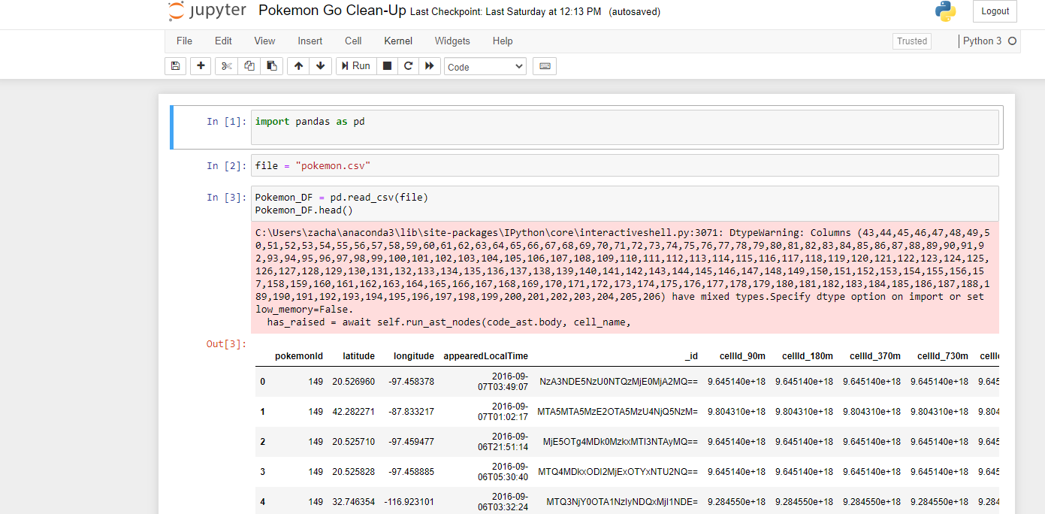
ETL PROCESS:
Step 2: DATA EXTRACTION & TRANSFORMATION
Pulled into jupyter notebook
“Cleaned Data”: Deleted columns we did not need
Specified North America (multiple conditions)
Renamed columns for final dataset & more!

Slide 4
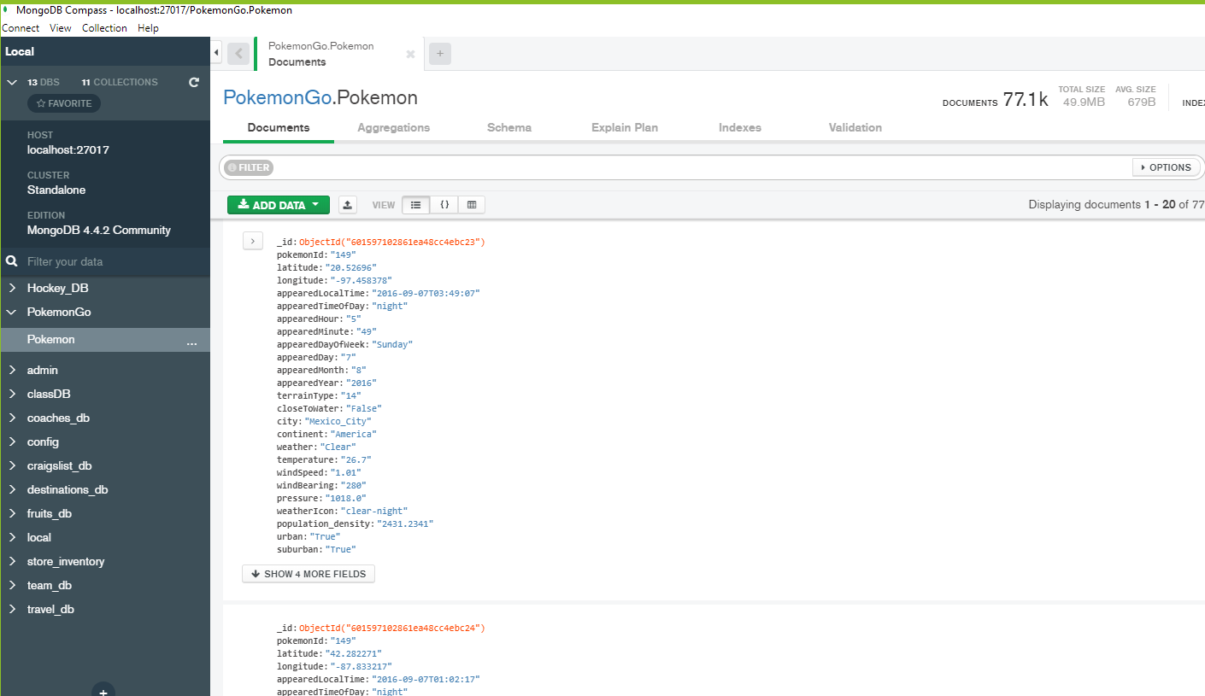
ETL PROCESS:
Step 3: PUSH TO A LOCAL DATABASE
Pushed to Mongo DB
Extracted a JSON file from Mongo DB

Slide 5
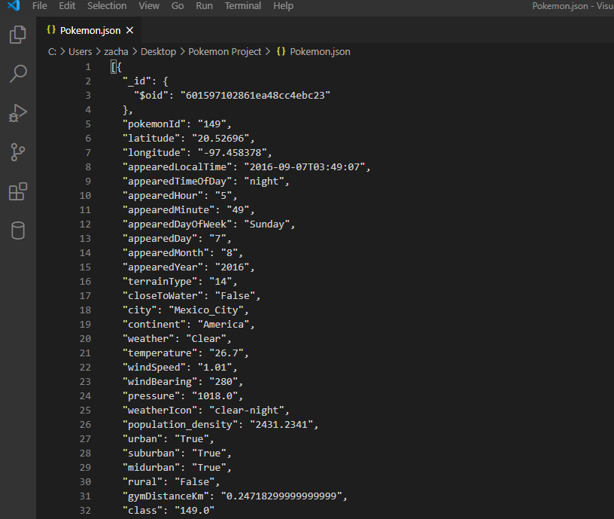
ETL PROCESS:
JSON FILE
Extracted JSON file from Mongo DB

Slide 6
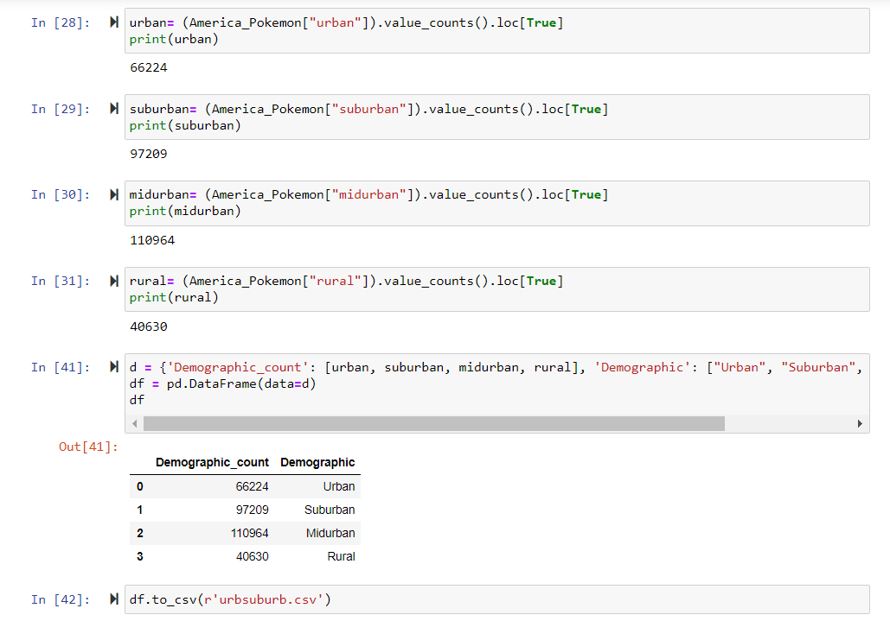
Step 4: Creation of Bar Chart
Pulled into Juypter notebook
.value_counts().loc[True]
Grabbed Desired Columns: Urban/Suburban/Midurban/Rural

Slide 7
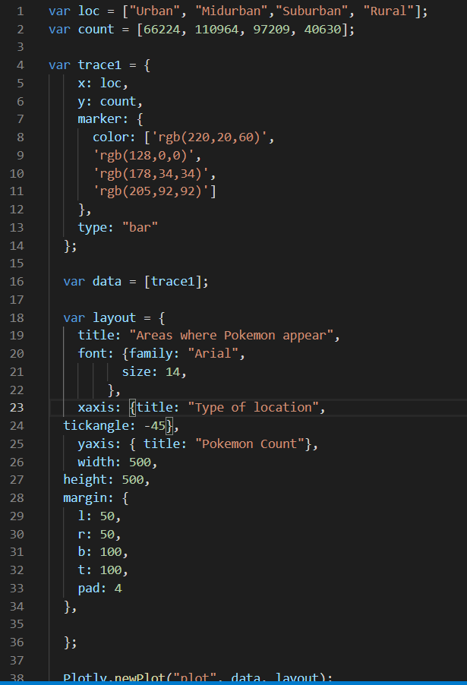
Step 4: Creation of Bar Chart (Con’t)
Created Bar Graph
Used the summary from csv file to fill in data for chart
Used Plotly
Plotted chart on html

Slide 8


Step 5: USING A NEW JS LIBRARY
Used a Javascript Math JS library function to Shuffle, Slice and Randomize 1000 datapoints within 77,000 datapoints. We were able to therefore use ALL our data for visualization!!.

Slide 9
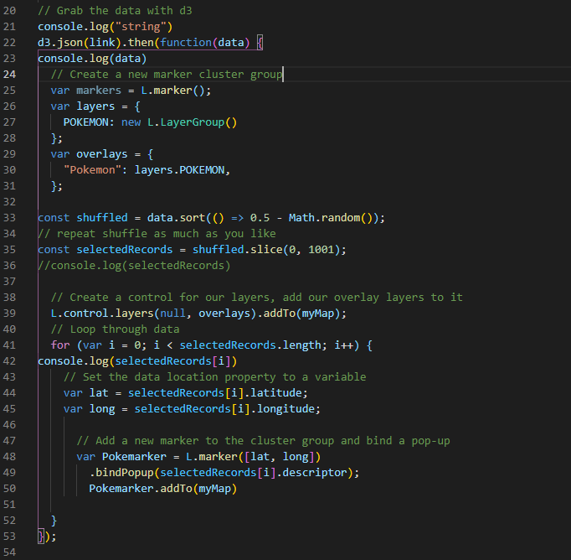
Step 6: Creating the Geomap: Population Density
Pull data from the Json using D3
Implement math.js Library to shuffle and create a smaller sample size.
Looped through data set to pull the latitude and longitude.
Add marker to map.

Slide 10
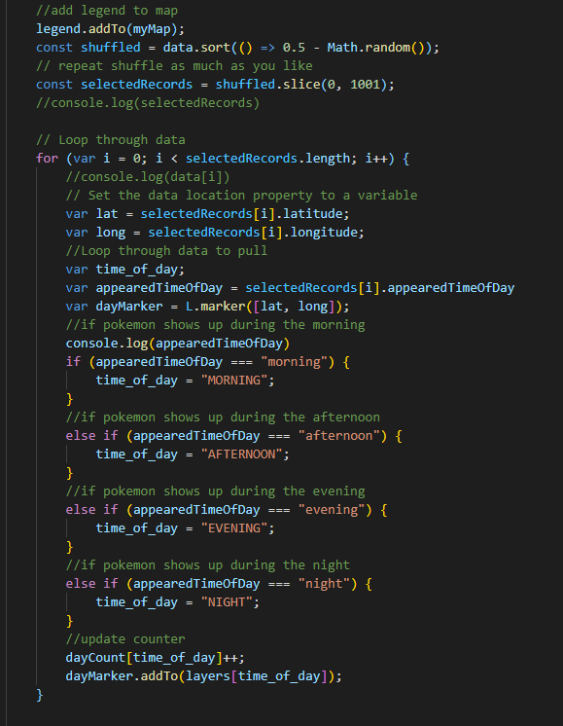
Creating the Geomap: Time of Day Layers
Still utilizing math.js library to create smaller sample size.
Loop through data to pull latitude and longitude based on “appeared time of day”
create a layer for each time of day.

